Slide 1

“HackDome – A Multiplayer CTF Platform for Secure Learning”
GROUP-3
BISHESH DULAL (11821780)
PRADIP SAPKOTA (11821781)
UJJWAL RANA MAGAR (11753791)
SALINA KHADKA (11695006)

Slide 2
Introduction
HackDome is a secure, gamified Capture The Flag (CTF) learning platform. It is designed to help users practice ethical hacking challenges in a safe and structured environment.
What Exactly is a CTF Challenge?
CTF or Capture the Flag is a “Hacking game” where players find “flags” or “secret codes” by solving hacking puzzles.
The goal of the player is to find the flaw, exploit it and “capture the flag”
There is no real system associated in CTF hacking, it attacks fake systems and the goal is to learn cyber security.

Slide 3
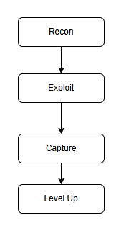
How CTF Really Works?
The Nuts and Bolts (Explained with an example)
Step 1: Reconnaissance- Find a login page, check source code,discover hint like a comment “admin:test123”
Step 2 : Exploit- Login with admin:test123
Step 3: Capture- FLAG{easy_password}
Step4: Level Up - Next harder task like cracking a hashed password

Slide 4
Types of Exploitation in CTF
Web Exploits:
SQLi, XSS, Broken Auth
Goal: Hack Websites
Binary Exploits
Buffer Overflow, Format Strings
Goal: Control programs
Crypto:
Weak Encryption, hidden data in images
Goal: Decode messages

Slide 5
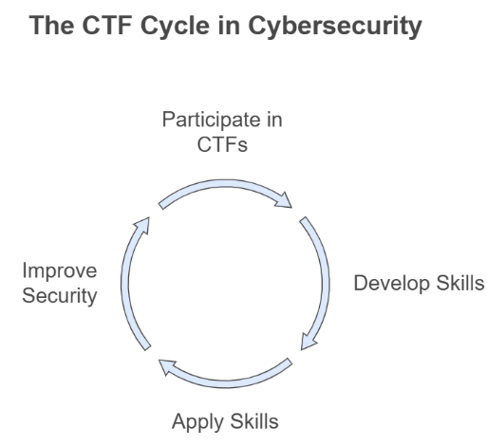
Importance of CTF in Real world
How Capture the Flag prepares you for cyber battles ?
Improve security awareness
Simulate real attacks(SQLi, phishing)
Learn defensive tactics
Develop Technical Skills
Master Tools (Burp Suite)
Practice reverse engineering, cryptography
Apply Skills in Real Scenario
Transition to jobs (pentesting)
Earn bug bounty (HackerOne)

Slide 6
Build Networks Through CTFs
Teamwork Makes the Dream Work
Splitting roles (web hacker + crypto expert = unstoppable)
Real time collab in platforms like Discord.
Global Hacker Network
Compete and learn with/from top CTF players worldwide.
Join Communities like Discord CTF servers (HTB survey: 60% of CTF players land job through connections)
Career Development Pathways
Recruiters monitor top CTF performers.
2023 SANS survey: 72% of cybersecurity professionals consider CTF experience useful in landing jobs.

Slide 7
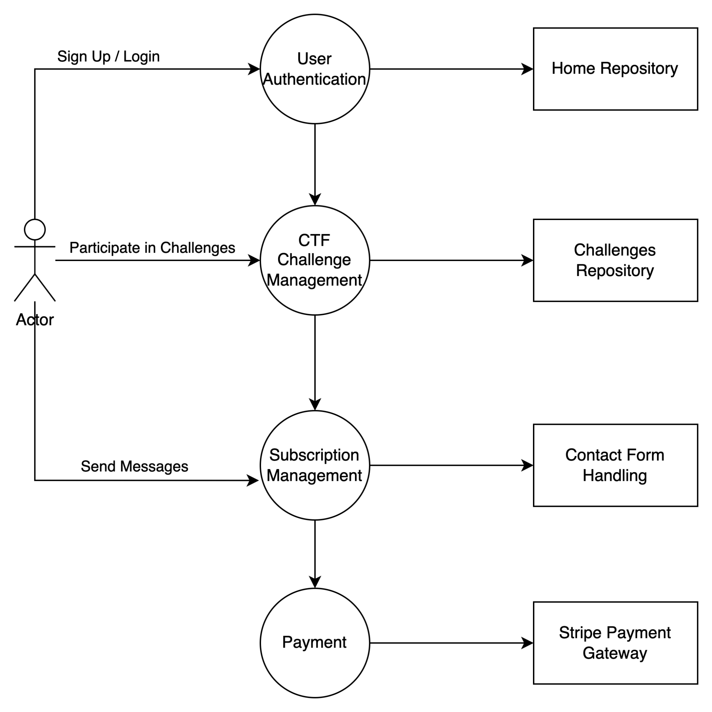
Data Flow Diagram

Slide 8
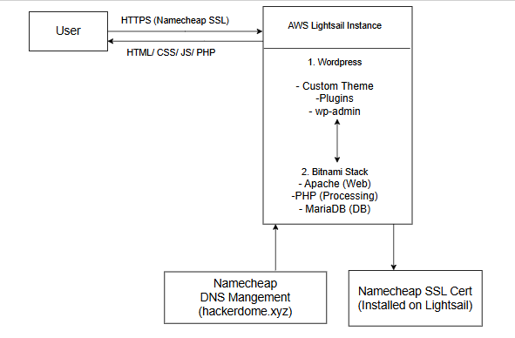
System Architecture

Slide 9
Tech Stack Used:
(Frontend)
HTML5, CSS3, JavaScript
Bootstrap 4
Owl Carousel (UI/UX elements)

Slide 10
Tech Stack Used (Backend):
PHP
Advanced Custom Fields (ACF)
CPT UI (Custom Post Types)
WordPress (CMS)

Slide 11
Tech Stack Used :
(Authentication & Payment)
Stripe Payment Gateway
miniOrange 2FA Plugin

Slide 12
Essential Security Measures
SSL (HTTPS): Encrypted communication between client and server.
Password Hashing: Securely stored using WordPress built-in hash algorithm.
Multi-Factor Authentication (MFA): Enabled via miniOrange plugin.
CSRF Protection: Nonce fields added to forms.
Cookie Flags: Secure and HttpOnly flags implemented.
Directory Protection: .htaccess configured to deny sensitive path access.
Auto-updates Enabled: Keeps WordPress, themes, and plugins patched.
Role-Based Access Control: Only admins can manage critical backend features.

Slide 13
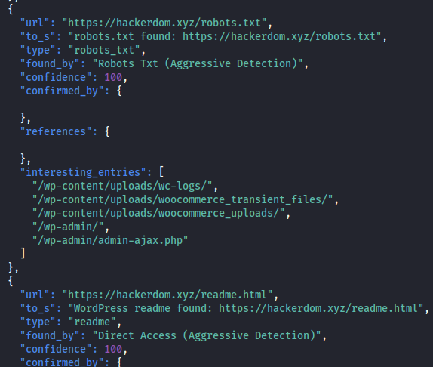
Result and Analysis
Tools used for the vulnerability assessment:
WPScan (WordPress vulnerability scanner)
Wapiti (Web app vulnerability scanner)
SQLMap (SQL Injection testing)
Nessus
Key FIndings:
readme.html and robots.txt revealed sensitive internal paths
No CSRF tokens detected on login and registration forms
Missing HTTP security headers: X-Frame-Options, X-XSS-Protection, Strict-Transport-Security
HttpOnly and Secure cookie flags were not set

Slide 14
Result and Analysis
Key Findings contd:
Username enumeration was possible via RSS feed
External access to wp-cron.php was enabled
Manual Testing:
On SQL injection using SQLMap, found the following:

Slide 15
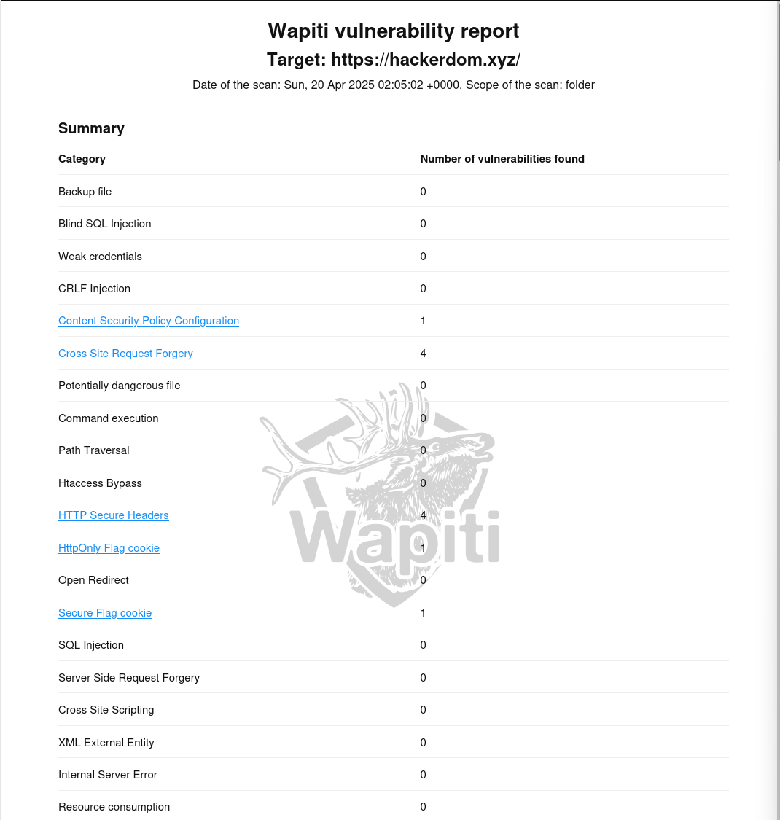
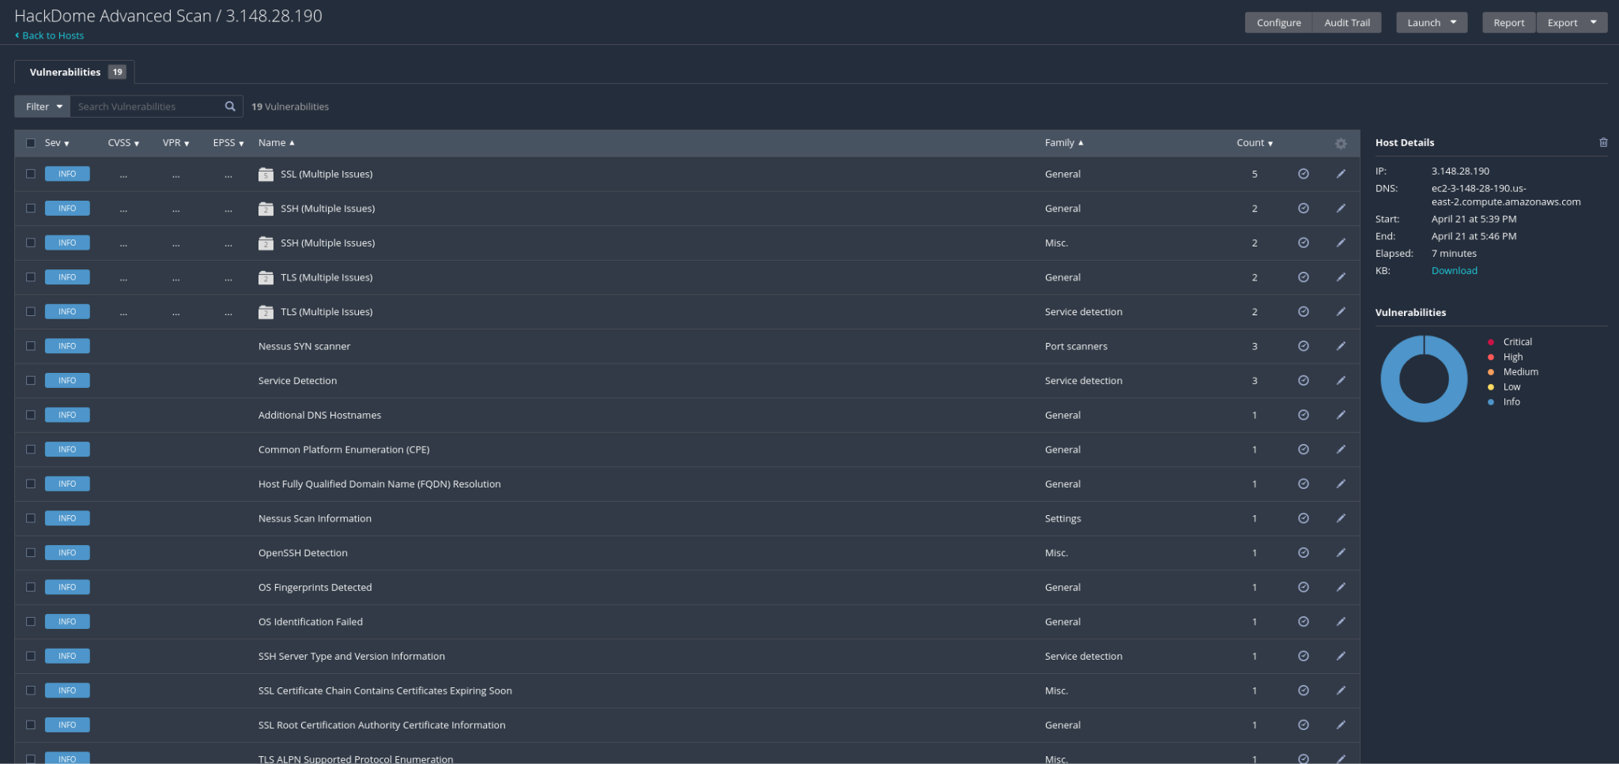
Result and Analysis
(Wapiti and Nessus Scan)

Slide 16
Result and Analysis
Fixes Implemented:
Removed readme.html and limited directory exposure in robots.txt
Implemented CSRF tokens on login and registration forms using WordPress nonce
Set HTTP security headers via .htaccess and security plugins
Enabled HttpOnly and Secure flags for session cookies in WordPress config
Blocked author ID enumeration using .htaccess and security plugin features
Disabled external wp-cron.php and replaced with server-side cron job

Slide 17
Future Work
Deploy isolated lab environments using Docker
Add real-time scoring & analytics for challenges
Red vs. Blue Challenge Competitions
Develop AI-based challenge recommendations
Add simulations for bug bounty, SQL Injection mode for advanced users
Built-in Pentesting tools for practice
AI-Powered Challenge Generator

Slide 18
Conclusion
Hackdome is a secured CTF platform for cybersecurity enthusiasts to test their knowledge and hone their skills. It is a work in progress and we will be enhancing the features of this platform in the near future. It will be accessible to all skill levels and focus on promoting cybersecurity awareness to the general public.
Demo Video: Click Here

Slide 19
References
Pathak, S. (2025, April 21). Why Capture the Flag (CTF) Events Are Essential for Cybersecurity Skills. Cyberyami.com; Cyberyami. https://www.cyberyami.com/blogs/why-capture-the-flag-ctf-events-are
-essential-for-cybersecurity-skills
‌SANS 2024 Security Operations Center Survey. (2025, January 8). AI Security Automation; Swimlane. https://swimlane.com/resources/reports/sans-soc-survey/
‌Cyber Attack Readiness Report 2024 | HTB Business CTF. (2024). Hackthebox.com. https://resources.hackthebox.com/cyber-attack-readiness-report-2024

Slide 20
Feedback and Questions?
We’d love your feedback!

